Slide 1



A Closed-form Lower Bound on the Allowable Motion for An Ellipsoidal Body and Environment
ASME/IDETC 2015 MR : Properties of Motion 47351
Qianli Ma, Gregory S. Chirikjian
Robot and Protein Kinematics Laboratory
Laboratory for Computational Sensing and Robotics
Department of Mechanical Engineering
Johns Hopkins University, Baltimore, MD, USA
Notes:
First, I want to thank you all for serving as the committee members of my GBO. My name is Qianli and I’m a third year mechanical engineering PhD student in Professor Chirikjian’s Robot and Protein Kinematics Lab. My topic today is “…”.
The problem of interest here is to analyze the constrained motion of a single ellipse or ellipsoid in a slightly larger elliptical or ellipsoidal environment. The goal is to have a closed form representation of configuration space of the contained ellipsoid, so that we can quickly determine whether the target ellipsoid is in collision with its environment.
Include DETC number on the first page

Slide 2
Outline
Problem
Motivation & Potential Application
Notes:
Pictures of a single ellipse and a single ellipsoid should be inserted here.

Slide 3
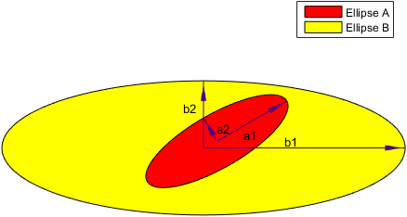
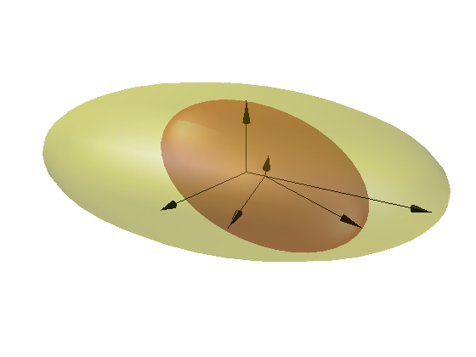
Problem
Given a single ellipse or ellipsoid constrained in another, what is its closed form representation of the configuration space (C-space) ?
Approach: Kinematics of Containment ^{[1]}
[1] Gregory S. Chirikjian, Yan Yan. (2014)

Slide 4
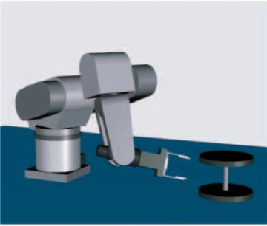
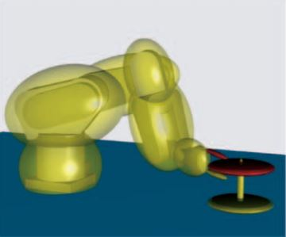
Motivation
Why Ellipses or Ellipsoids?
Benefit
Can approximate the shape of an object using relatively fewer parameters
Applications
A simpler bounding box can be defined for collision checking algorithms ^{[1-3]}
[1] Choi, Y.-K., et al. (2009) [2] Shiang, S.-P. et al. (2000) [3] Wu, C.-J. (1996)
Notes:
The first step to verify whether a rabbit robot is contained in a slightly larger one is by looking at the condition of containment of each elliptical link. If we start from general ellipsoids in n dimension.

Slide 5
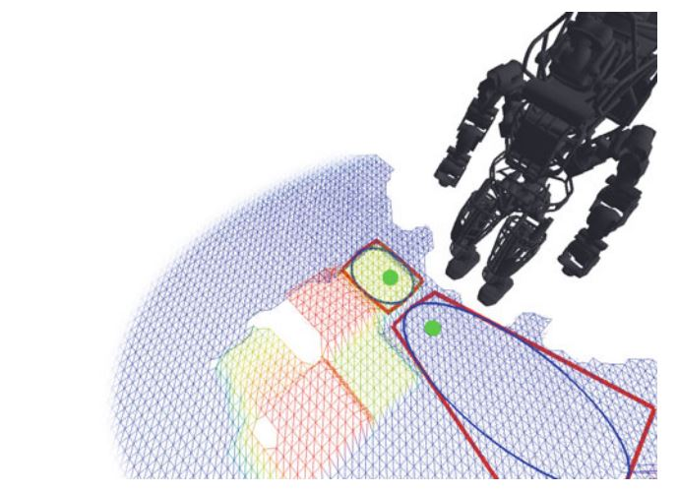
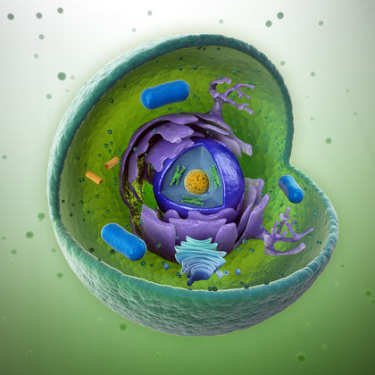
Motivation
Why a Single Ellipse or Ellipsoid?
Motion of an organelle inside a cell
Mobility of a medical tool in an ultrasound image
Gait planning of the feet of a humanoid robot ^{[1]}
The first step towards multi-ellipse or multi-ellispoid body
[1] Robin Deits, Russ Tedrake. (2015)
Notes:
The first step to verify whether a rabbit robot is contained in a slightly larger one is by looking at the condition of containment of each elliptical link. If we start from general ellipsoids in n dimension.
Pronunciation of organelle
Too much time on this slide

Slide 6
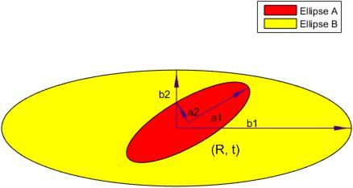


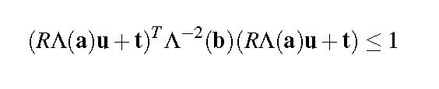
First Order Condition of KC
Motion of Single Ellipse/Ellipsoid Inside a Slightly Larger Elliptical & Ellipsoidal Arena
Implicit and explicit equations for ellipsoid A and B
Condition for Kinematics of Containment ( A contained in B )
where R is rotation and t is translation
Notes:
The first step to verify whether a rabbit robot is contained in a slightly larger one is by looking at the condition of containment of each elliptical link. If we start from general ellipsoids in n dimension.
Describe in words: Apply the rigid transformation onto the ellipsoid A
Change the x in the second equation into y

Slide 7


First Order Condition of KC
Condition for Kinematics of Containment ( A contained in B )
First Order Approximation of the Rotation Matrix R
IF
THEN
Question: Is it possible to get a closed form solution of both r and t ?
Notes:
The first step to verify whether a rabbit robot is contained in a slightly larger one is by looking at the condition of containment of each elliptical link. If we start from general ellipsoids in n dimension.

Slide 8


A Closed-form Representation
ANSWER : Not directly, but a workaround exists.
For
Step 1. Factoring out r and t into z = [r; t ] will give :
Note : A closed-form solution doesn’t exist for z
Step 2. Instead, look for a subset of z which can be described in closed form as:
where B is a square matrix and
Note: n is the dimension of the (hyper-) ellipsoid
Notes:
The extraction is possible so that both the H matrix and the litter h vector depend only on vector u. But still it is very hard to have a closed form solution for z which represents the subset of C-space. We instead look at a subset of z defined by this equation where B is a square matrix and w is a unit vector. The problem is converted into finding the constraint on matrix B. In order to find the constraint, we substitute the new expression of z into the equation C(z) and after empolyinng certain matrix norm ineqautlities then we have the constraint on the norm of matrix B. We force this (what number) equation to be less or equal to 1 and we will get the following expression.
DECRIBE EQUATIONs FROM HIgH LEVEL PERspeCTIVE
To correct:
Remove the last line of the 3rd equation
Brief description or simple expression for H, h and c
Include w^Tw = 1

Slide 9
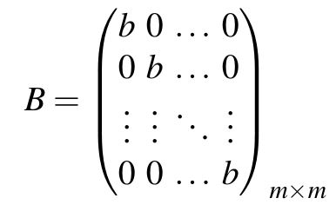

A Closed-form Representation
Question: How to construct matrix B ?
The most simple way is to construct matrix B:
( The volume of motion determined by the eigenvalues of B, and without loss of generality, the above matrix B can represent the set of matrix B which has identical positive eigenvalues. ) Describe this and equation for the volume of motion
A diagonal matrix B with different diagonal eigenvalues can be designed, but it fails to result in a larger volume of motion, which will be explained later.

Slide 10
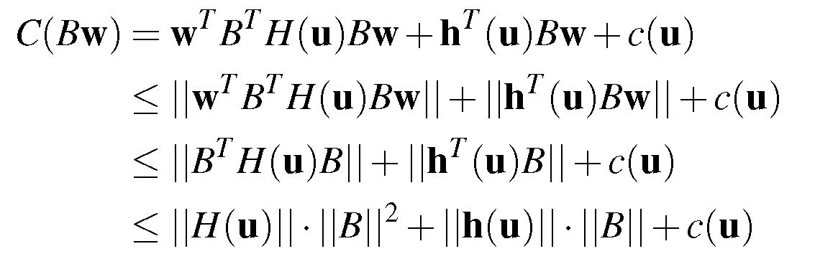

A Closed-form Representation
Step 3. Get the constraint on matrix B as :
Namely,
Notes:
The extraction is possible so that both the H matrix and the litter h vector depend only on vector u. But still it is very hard to have a closed form solution for z which represents the subset of C-space. We instead look at a subset of z defined by this equation where B is a square matrix and w is a unit vector. The problem is converted into finding the constraint on matrix B. In order to find the constraint, we substitute the new expression of z into the equation C(z) and after empolyinng certain matrix norm ineqautlities then we have the constraint on the norm of matrix B. We force this (what number) equation to be less or equal to 1 and we will get the following expression.
DECRIBE EQUATIONs FROM HIgH LEVEL PERspeCTIVE
To correct:
Remove the last line of the 3rd equation
Properties of Norm
Triangular inequalities.

Slide 11
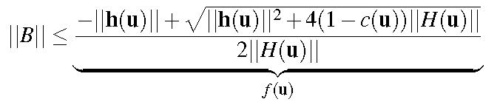

A Closed-form Representation
Step 4: Root Inequality
Step 5: Equality Constrained
Minimization Problem
Notes:
Change Bnl back to B

Slide 12
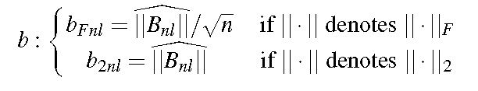
A Closed-form Representation
Since we constrain matrix B to be a diagonal matrix with all the diagonal elements being b, then a unique B can be determined by the constraint condition on B.
Step 6: Classification Based on
the Type of Norm

Slide 13

C-Spaces of the Contained Ellipsoid
CC-space (in r and t)
(complete C-space) (R = exp([S(r)]))
SC-space (in z)
(sub C-space)
CSC-space (in z)
(closed-form sub C-space)
Notes:
Why are you shrinking the C-space all the time. (For easy and fast connection of C-space samples )
Largest convex object in CC-space that is easy and fast for evaluating containment
z = b
Change c to c(u)

Slide 14
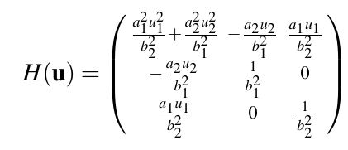
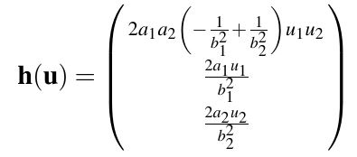

KC for 2D Ellipse
a1 = 5
a2 = 3
b1 = ( 1 + Ɛ )*a1
b2 = ( 1 + Ɛ )*a2
Ɛ = 0.3

Slide 15
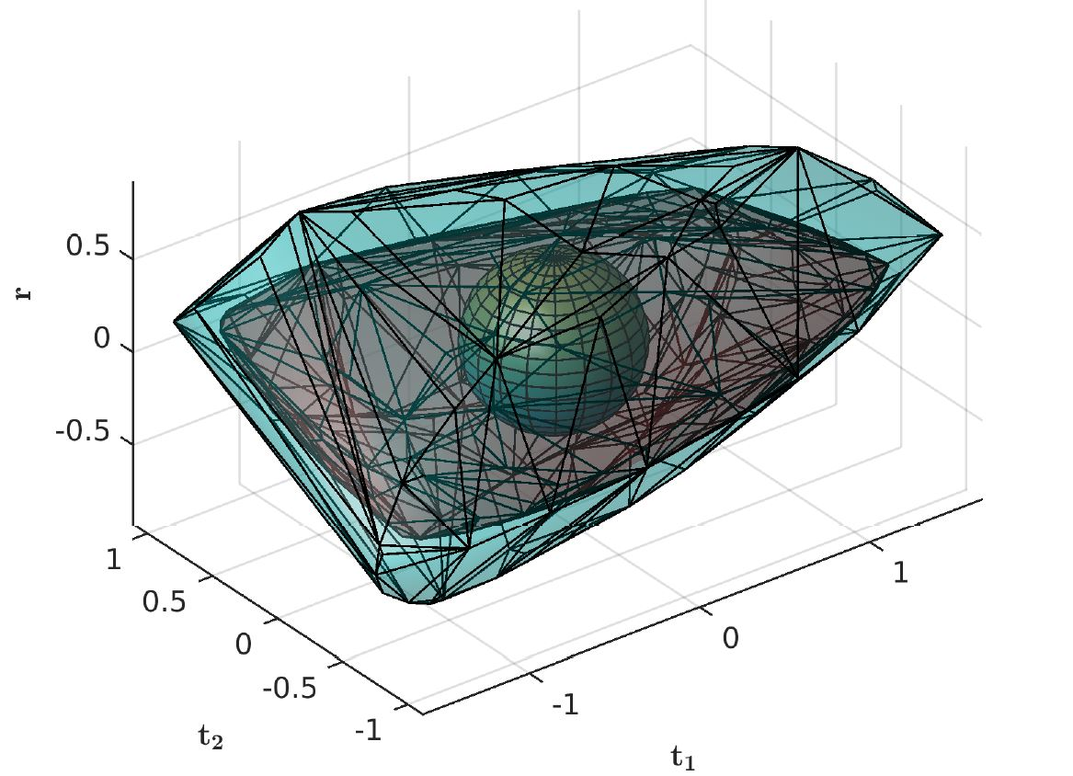
KC for 2D Ellipse
C-space in se(2)
Sphere: CSC-Space
Red Convex Hull: SC-Space
Blue Convex Hull: CC-Space
a1 = 5
a2 = 3
b1 = ( 1 + Ɛ )*a1
b2 = ( 1 + Ɛ )*a2
Ɛ = 0.3

Slide 16
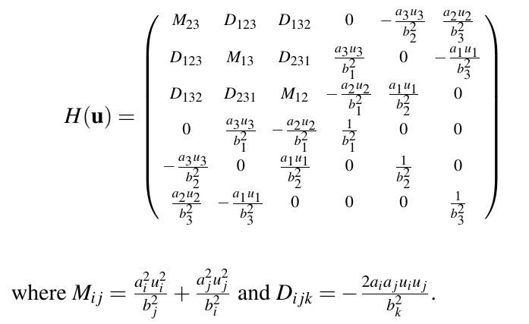
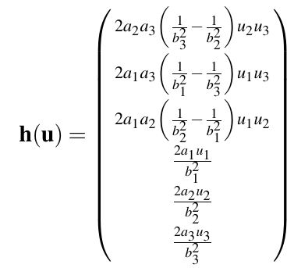
KC for 3D Ellipsoid
a1 = 5
a2 = 3
a3 = 2
b1 = ( 1 + Ɛ )* a1
b2 = ( 1 + Ɛ )* a2
b3 = ( 1 + Ɛ )* a3
Ɛ = 0.3

Slide 17
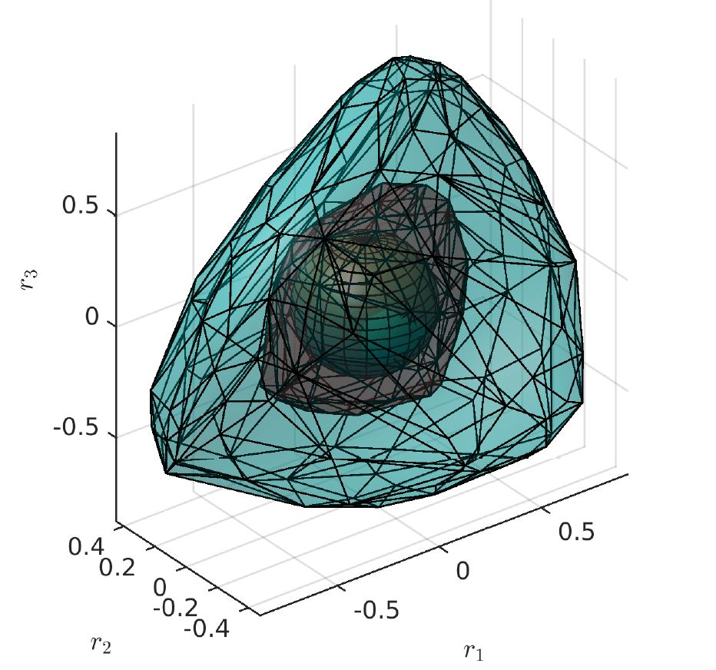
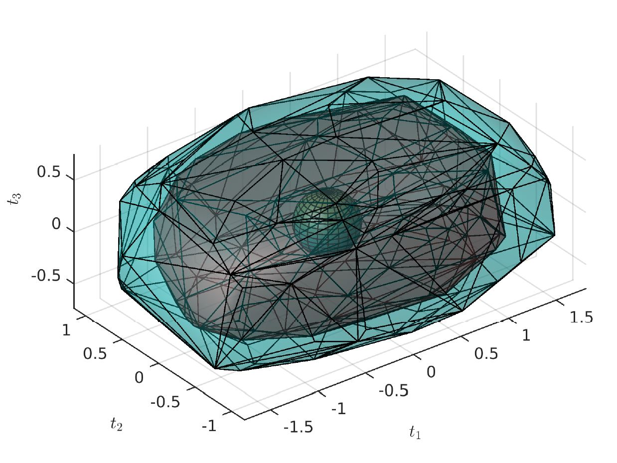
KC for 3D Ellipsoid
C-space in so(3) C-space in R^3
Sphere: CSC-Space
Red Convex Hull: SC-Space
Blue Convex Hull: CC-Space
a1 = 5
a2 = 3
a3 = 2
b1 = ( 1 + Ɛ )* a1
b2 = ( 1 + Ɛ )* a2
b3 = ( 1 + Ɛ )* a3
Ɛ = 0.3
Notes:
Attach a1, a2, a3, b1, b2, b3 onto the figure

Slide 18
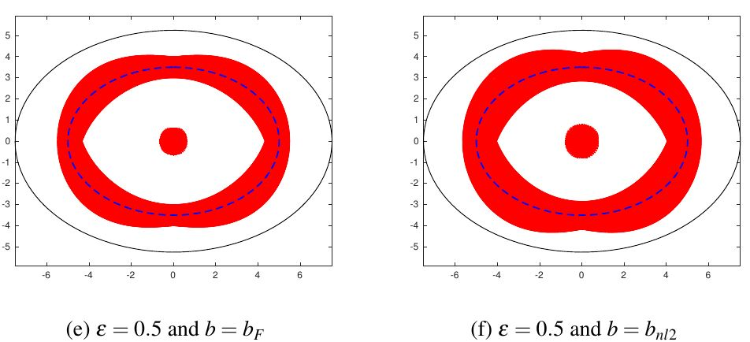
Numerical Simulation and Visualizations
Semi-axes lengths of ellipse A and B:
a1 = 5
a2 = 3
b1 = ( 1 + Ɛ )*a1
b2 = ( 1 + Ɛ )*a2
Ɛ = 0.1, 0.3, 0.5

Slide 19
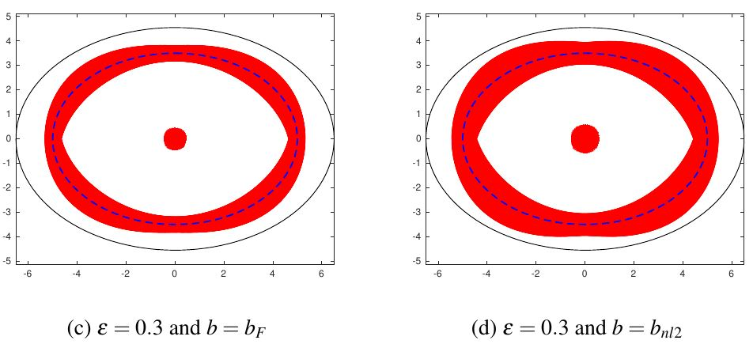
Numerical Simulation and Visualizations
Semi-axes lengths of ellipse A and B:
a1 = 5
a2 = 3
b1 = ( 1 + Ɛ )*a1
b2 = ( 1 + Ɛ )*a2
Ɛ = 0.1, 0.3, 0.5

Slide 20
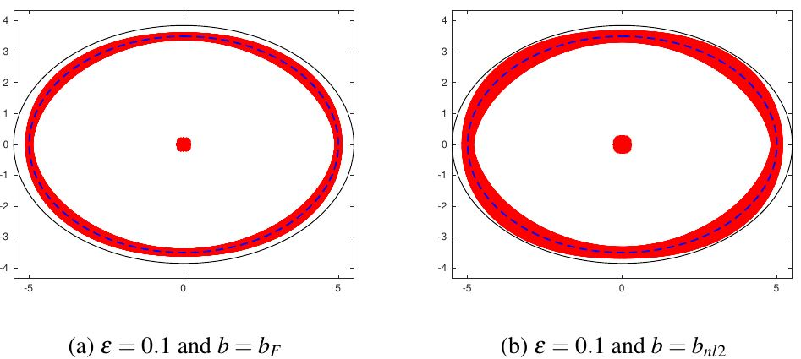
Numerical Simulation and Visualizations
Semi-axes lengths of ellipse A and B:
a1 = 5
a2 = 3
b1 = ( 1 + Ɛ )*a1
b2 = ( 1 + Ɛ )*a2
Ɛ = 0.1, 0.3, 0.5

Slide 21
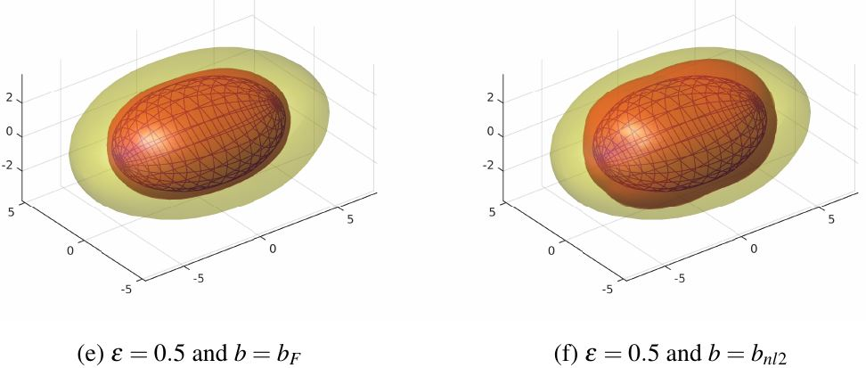
Numerical Simulation and Visualization
Semi-axes lengths of ellipsoid A and B:
a1 = 5
a2 = 3
a3 = 2
b1 = ( 1 + Ɛ )* a1
b2 = ( 1 + Ɛ )* a2
b3 = ( 1 + Ɛ )* a3
Ɛ = 0.1, 0.3, 0.5

Slide 22
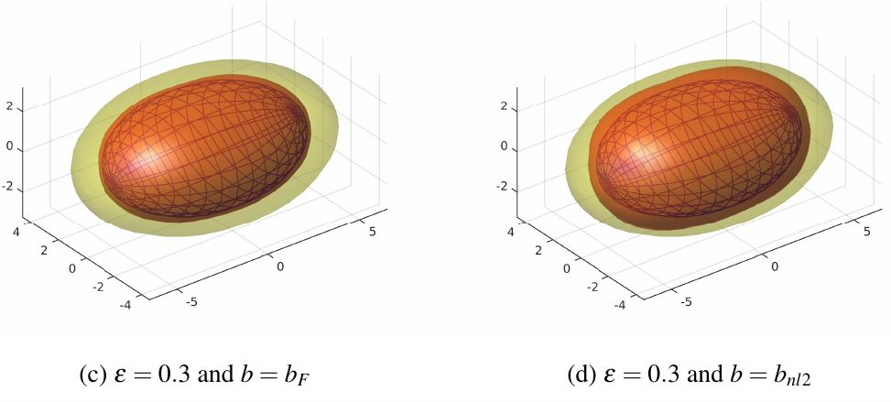
Numerical Simulation and Visualization
Semi-axes lengths of ellipsoid A and B:
a1 = 5
a2 = 3
a3 = 2
b1 = ( 1 + Ɛ )* a1
b2 = ( 1 + Ɛ )* a2
b3 = ( 1 + Ɛ )* a3
Ɛ = 0.1, 0.3, 0.5

Slide 23
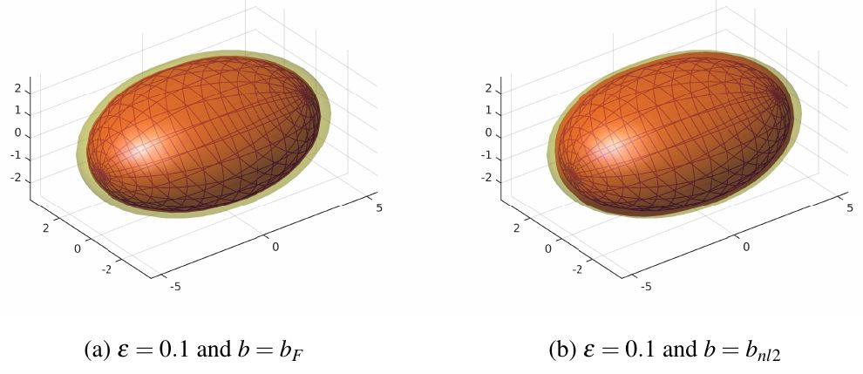
Numerical Simulation and Visualization
Semi-axes lengths of ellipsoid A and B:
a1 = 5
a2 = 3
a3 = 2
b1 = ( 1 + Ɛ )* a1
b2 = ( 1 + Ɛ )* a2
b3 = ( 1 + Ɛ )* a3
Ɛ = 0.1, 0.3, 0.5

Slide 24
Conclusion
A CSC-space is found to be fully enclosed in the complete C-space of the constrained ellipsoid
The CSC-space has a larger volume when choosing matrix 2-norm for the nonlinear optimization technique
The characterized CSC-space for the contained ellipse is big enough, while
To be Added

Slide 25
Future Work and Open Problems
1. A possible larger fitting (hyper-)sphere using 2nd order approximation of rotation
2. Find a better fitting (hyper-)ellipsoid inside the CC-space instead of the current (hyper-)sphere
3. Closed form representation of the CSC-space for multi-ellipsoidal body
4. Implement the algorithm of kinematics of containment in existing path planners

Slide 26
Acknowledgements
Lab website : https://rpk.lcsr.jhu.edu/
Thank you for listening
Any questions?
Notes:
Half a minute per slide!!!

